Slide 1





Melon: Breaking the Memory Wall for Resource-Efficient On-Device Machine Learning
Qipeng Wang^{1*}, Mengwei Xu^{2*✉️}, Chao Jin¹, Xinran Dong¹, Jinliang Yuan², Xin Jin¹,
Gang Huang¹, Yunxin Liu³, Xuanzhe Liu^{1 ✉️}
(*co-primary, ✉️corresponding)
¹Key Lab of High Confidence Software Technologies (Peking University)
²State Key Laboratory of Networking and Switching Technology (BUPT)
³Institute for AI Industry Research (AIR), Tsinghua University
Notes:
Hello, everyone. I‘m Qipeng Wang from Peking University. Today, I will share with you our recent work: Melon: Breaking the Memory Wall for Resource-Efficient On-Device Machine Learning

Slide 2



DNN is a key component for mobile app
Face recognition
Voice recognition
Augmented Reality
Mainly DNN inference now
Notes:
Nowadays, Deep neural network has been a key component of today’s mobile application, like face and voice recognition.
(click)
However, these apps mainly runs DNN inference now.

Slide 3

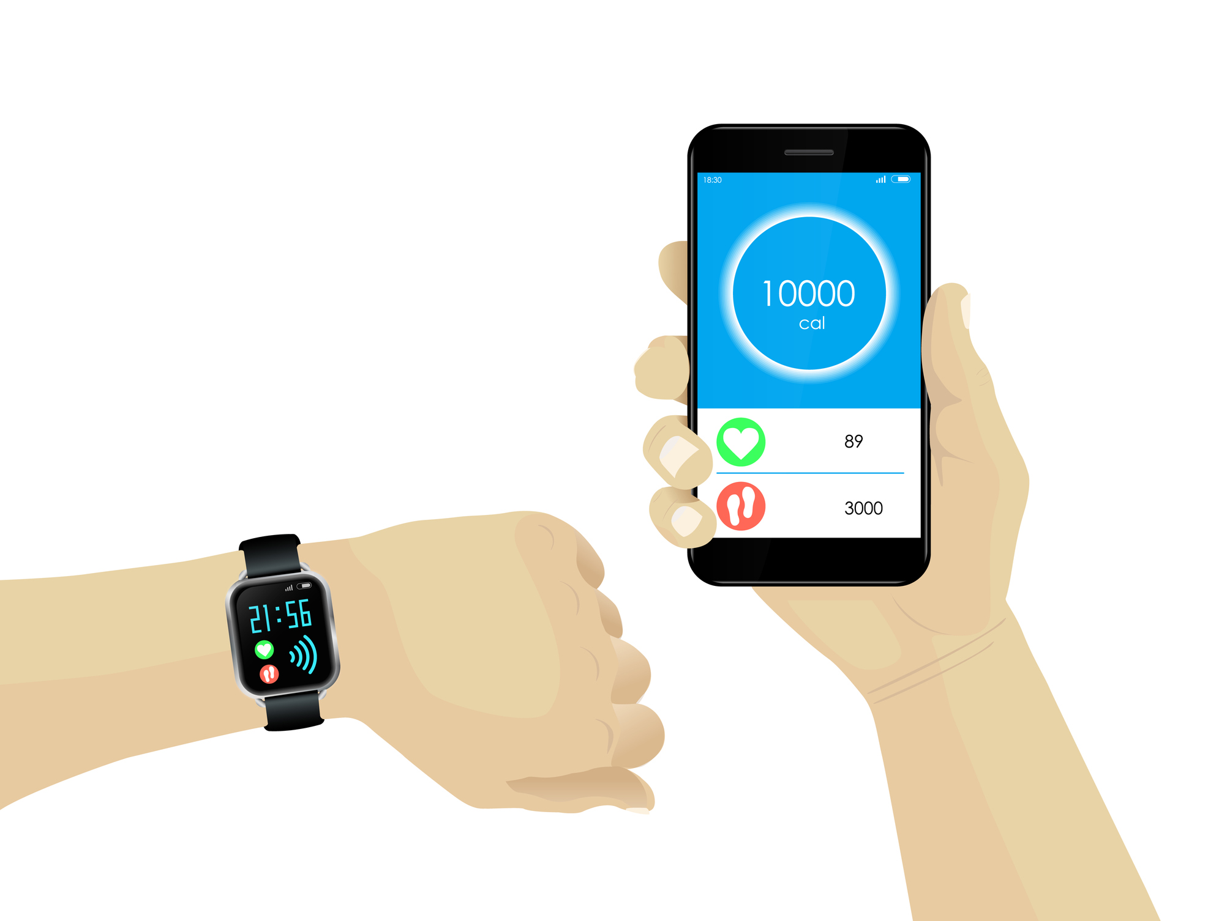



Emerging on-device learning
Server
Notes:
As for training
(click1)
traditional approach collects user data to cloud server, and trains global model based on the whole dataset. But it may cause privacy concerns.
(click2)
As a forward step, researchers have proposed on-device training, which trains the model on user’s device with only the data stored on the device, without upstreaming the data to cloud server, avoiding private data leaking.
(click3)
Moreover, on-device learning has been a key enabler of emerging learning paradigms, like federated learning.

Slide 4
Whether the training of modern DNN is affordable on mobile devices?
Notes:
However, training DNN is an memory-intensive task. It’s intuitive to ask “whether the training of modern DNN is affordable on mobile devices?”

Slide 5
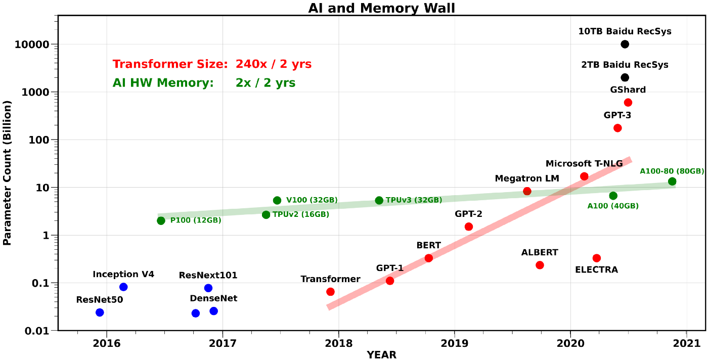
Preliminaries: memory wall
Transformer Size
AI Hardware Memory
Mobile Device Memory
Training DNN with large batch size/model is not affordable on mobile device
Notes:
To answer this question, we first conduct preliminaries.
For current popular mobile devices and DNN models, we investigate the model size and hardware memory capacity. This figure shows that the model size grows much faster than that of hardware memory capacity, especially the mobile devices.
(click)
It indicates that “Training DNN with large batch size/model is not affordable on mobile device”

Slide 6

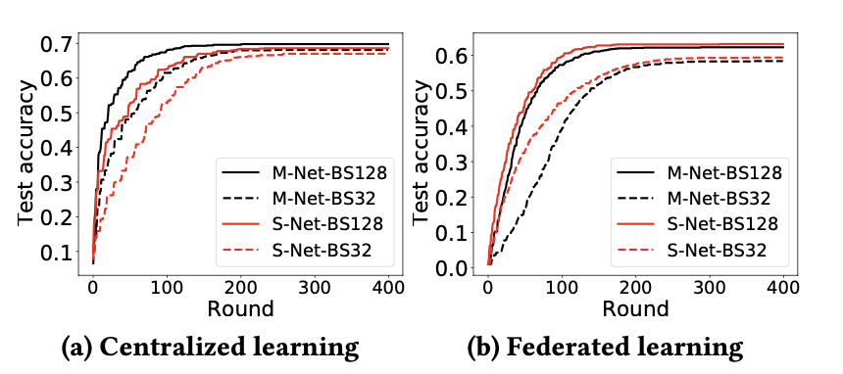
Preliminaries: memory wall
3.94%
Significant
accuracy drop
Notes:
Next, we measure the training performance of different models with different batch size, under centralized and federated settings.
(click)
Our measurement shows that training models with larger batch size can converge faster and get model with higher performance. For example, training with smaller batch size introduces significant accuracy drop under federated settings.

Slide 7

Preliminaries: memory wall
39.02% longer
convergence time
Notes:
It also leads to longer convergence time.

Slide 8
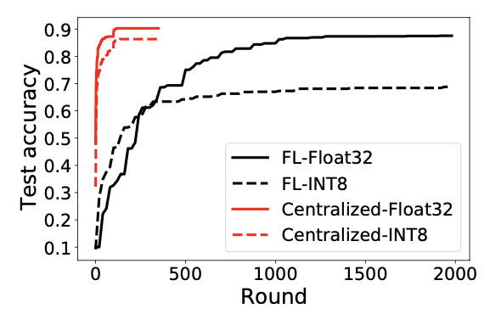
Preliminaries: existing techniques
Model & gradients compression
Significant accuracy drop
Notes:
Next, we explore existing techniques that are widely used in cloud community.
The first is model and gradient compression during training, with use lower precision representation to store data, to reduce the model and activation size.
(click)
However, through our measurement, we find that this method will lead to significant accuracy drop, especially in federated settings.

Slide 9
Preliminaries: existing techniques
Model & gradients compression
Host-device memory swapping
Performance is blocked significantly by I/O speed of mobile devices
Notes:
The second is host-device memory swapping. This method virtualizes device and host memory and performs memory swapping between two types of memory. This method is widely used in cloud community, because of the high bandwidth of NVLink and PCIe. However, mobile device lacks such hardware support, leading this technique significantly blocked in mobile scenario.

Slide 10
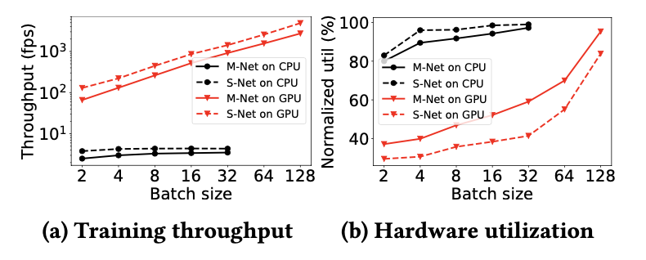
Preliminaries: existing techniques
Model & gradients compression
Host-device memory swapping
Splitting mini-batch to micro-batch
Notes:
The third is “Splitting mini-batch to micro-batch”. This technique is used not as widely as swapping, mainly because it will compromise the parallelism of cloud GPU. However, according to our measurement, a relative small batch size is enough to reach the highest hardware utilization on mobile device.

Slide 11
Preliminaries: existing techniques
Model & gradients compression
Host-device memory swapping
Splitting mini-batch to micro-batch
Activation recomputation
Device/hardware agnostic
Notes:
The fourth is “activation recomputation”. This technique evicts activation during the forward pass for training and recomputes them when they are needed during the backward pass. This technique make a trade-off between training time and memory footprint. Moreover, it is device/hardware-agnostic.

Slide 12
Preliminaries: existing techniques
Model & gradients compression
Host-device memory swapping
Splitting mini-batch to micro-batch
Activation recomputation
Notes:
In summary, there are several techniques to reduce the memory footprint during the training process in cloud scenario.
(click)
However, not all of them are compatible with mobile scenario.

Slide 13
How to break the memory wall
for on-device learning?
Notes:
Based on these preliminaries, our research question is, “How to break the memory wall for on-device learning?”

Slide 14

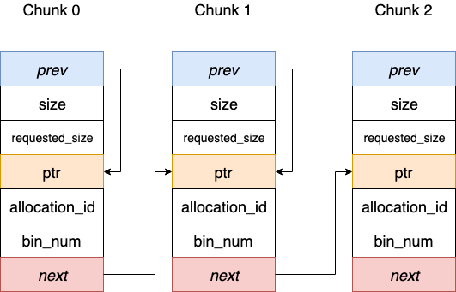



Challenge#1: efficient memory management
Memory pool is widely adopted
How to manage memory pool efficiently for DNN training?
Notes:
To do so, there are several challenges.
First, there are tens of thousands of memory allocation and release during training. To efficiently manage the memory, memory pool is widely used in most frameworks.
(click1)
For example, TensorFlow maintains a memory pool based on BFC algorithm. However, these pools are designed for general purpose, which ignore the characteristic of DNN training.
(click2)
So the first challenge is “How to manage memory pool efficiently for DNN training?”

Slide 15
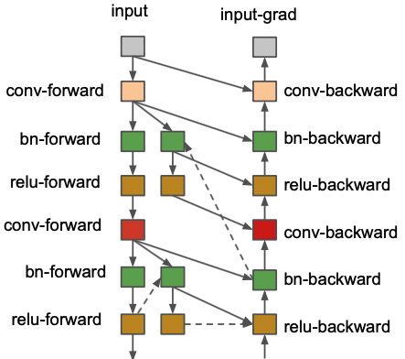
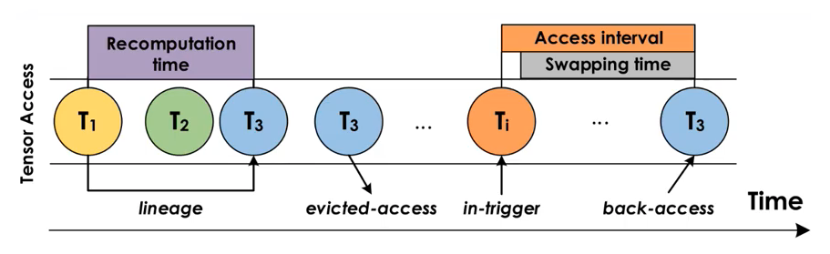
Challenge#2: efficient recomputation
Current recomputation ignores impact of memory pool
How to recompute efficiently based on DNN training specific memory pool?
Notes:
As for recomputation, current efforts make decision based on naïve assumption that the memory footprint of training is equal to the sum size of all tensors, which ignore the effect of memory pool.
(click)
So the second challenge is “How to recompute efficiently based on DNN training specific memory pool?”

Slide 16

Challenge#3: efficient training context switch
Resource competition due to other apps
Old training
progress
Available memory
shrinks
Reserve previous results rather than dropping them
New training
progress
How to switch context efficiently with less resource waste?
Notes:
In mobile scenario, there are usually multi-apps running in background, leading to significant resource competition. The available memory resource may change due to the competition.
(click1)
For instance, if the available memory shrinks,
(click2)
the system should stop the old training process, and return memory to OS as soon as possible.
(click3)
When the old process is stopped, the system should reserve previous results as possible to avoid resource waste,
(click4)
and then start a new one.
(click5)
So the question is “How to switch context efficiently with less resource waste?”

Slide 17

Melon: design overview
Decision
stage
Hardware
profile
Execution plan generator
…
Execution profiler
Memory layout
Kernel-level
Characteristics
Op reserving &recomputing
Batch
splitting
…
Deployed
DNN
Execution engine
Optimal execution
plans
Training engine
Adapting engine
Memory budge
Dataset
App or OS
Execution stage
Notes:
The answer is Melon. A memory efficient on-device training framework.
Melon mainly consists of three components.
(click1)
The first is execution profiler, which profiles the kernel-level characteristic of training process at the beginning of the training.
(click2)
Then it passes the profiled information to the execution plan generator. The generator will generate execution plans based on the information received. The execution plan consists of 3 types of information, that is, how to allocate each tensor, how to recompute optimally based on the pool, and how to split data batch.
Through preliminaries, we find that splitting batch is effective for models without BN-like layers, and we use the maximal size the device supports.
(click3)
After the plans generated, they are passed to execution engine, which trains model based on the plans and developer specified memory budget.

Slide 18
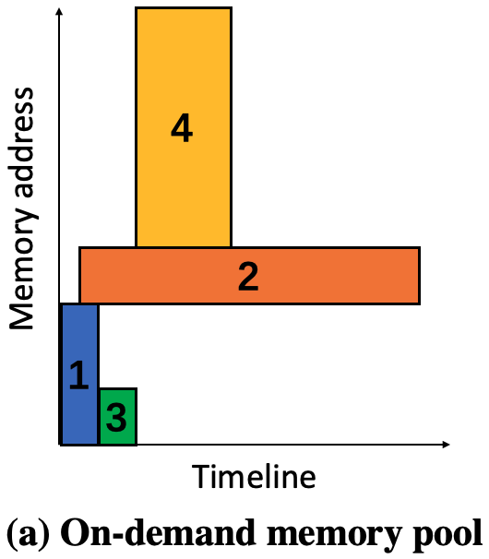
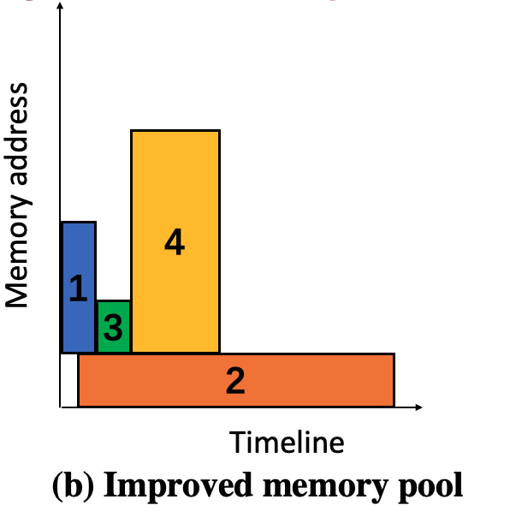
Tensor lifetime-aware memory pool
Heuristic
Memory access pattern of DNN training is fixed
Tensors allocated earlier are released later
Reduced
memory usage
Global info
Notes:
To manage memory efficiently, we propose Tensor lifetime-aware memory pool. Our heuristic is the memory access pattern of DNN training is fixed, so we can do optimal allocation based on the global information.
(click1)
For example, this is an on-demand memory pool, where the x-axis represents the lifetime of each tensor or the timeline and y-axis represents size of each tensor or the memory address.
(click2)
If we have the global information of each tensor, we can allocate the tensor#2 first.
(click3)
In such case, we can save memory usage.
Our pool allocates tensor with longest lifetime first because we find that tensor allocated earlier is released later in training.

Slide 19
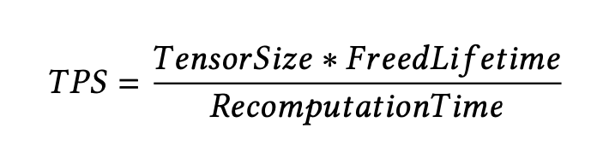
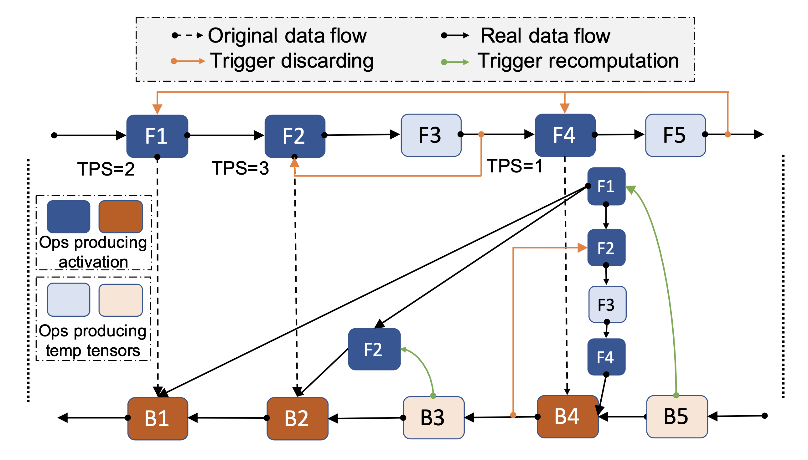
Memory-calibrated progressive recomputation
Recomputation mechanism
Evict tensor when exceeding memory budget
Recompute tensor when it is not appeared
❌
❌
Notes:
To recompute efficiently based on memory pool, we propose “Memory-calibrated progressive recomputation”. It will evict tensor when current memory usage exceeds budget, and will recompute the tensor when it is not appeared in memory.
(click1)
To decide which tensor to be evicted, we use the metric TPS to evaluate the benefit.
(click2)
TPS indicates that tensor with larger released area in memory pool and less recomputation time are preferred to be evicted. That is, it will release more space to reuse and introduce less additional overhead.
The recomputation is performed in a progressive way.
(click3)
For example, when memory budget is exhausted after F3,
(click4)
Tensor with maximal TPS is evicted.
(click5)
When tensor is needed during backward pass, recomputation is triggered and all the needed tensor are recomputed.
It will terminate when all tensors are computed.

Slide 20


Memory-calibrated progressive recomputation
Take memory pool into consideration
Tensor lifetime
Memory pool
Recomputation
Memory usage
Budget
Memory
Progressive
recompuation
Memory
Time
Time
Notes:
To take the memory pool into consideration during recomputing, we face the following dilemma.
(click1)
Both the pool and recomputation need global information from each other.
(click2)
That is, memory pool needs the tensor lifetime information, which is influenced by recomputation.
(click3)
While recomputation needs memory usage information to make decision, which is influenced by memory pool.
(click4)
This is a “chicken or the egg” dilemma.
To deal with this, we calibrate the memory pool during recomputing.
(click5)
For example, the pool is initialized as following.
(click6)
Melon performs recomputation progressively.
(click7)
We assume that we have a memory budget, and an empty pool.
(click8)
It allocates each tensor to the exact address as initialized.
(click9)
When the allocated tensor’s tail exceeds the budget, Melon evicts allocated tensors according to TPS, and the new tensor can sink down.
(click10)
When the evicted tensors are needed, Melon recomputes them and extends the memory pool to fit them.
(click11)
In such way, we can solve the dilemma.

Slide 21


On-the-fly memory budget adapting
To avoid resource waste when memory budget changes
Plan-6G
Plan-4G
Memory pool
Macro batch
Memory pool
Macro batch
Memory
usage
Tensor
profile
Memory
usage
Tensor
profile
Recomputation
Recomputation
❌
A
In-memory tensors of Plan-6G
reserve
B
$$∩$$
C
B
Reserved tensors after realloc
recompute
C
-
B
C
Needed tensors of Plan-4G
Notes:
To avoid resource waste when memory budget changes, we propose On-the-fly memory budget adapting.
(click1)
For example, the device is training DNN based on plan with 6GB budget.
(click2)
However, available memory budget shrinks during training.
(click3)
We use set A to denote in-memory tensors of old plan.
(click4)
Now we need to switch to new plan under 4GB memory budget. In such plan, the tensor needs to appear is denoted as set C.
(click5)
The reserved tensors of set A after reallocing are denoted as set B.
(click6)
So Melon reserves the tensors of the intersection of set B and C, and recomputes tensor of the difference of set C and B.
In this way, Melon can response to memory changes quickly and avoid resource waste as much as possible.

Slide 22
Evaluation: setting
Devices and models:
Baselines:
vDNN^{[1]}: host-device memory swapping
Sublinear^{[2]}: checkpoint-based recomputation
Capuchin^{[3]}: tensor-based swapping and recomputation
Ideal: ideal case that supposes memory is infinite
Device | SoC | Memory
Samsung Note10 | SnapDragon 855 | 8GB
Meizu 16T | SnapDragon 855 | 6GB
Redmi Note9 Pro | SnapDragon 720 | 6GB
Redmi Note8 | SnapDragon 655 | 4GB
Model | Parameters
MobileNetV1 | 3.3M
MobileNetV2 | 2.4M
SqueezeNet | 0.8M
ResNet50 | 23.8M
[1] Rhu et al. vDNN: Virtualized deep neural networks for scalable, memory-efficient neural network design. MICRO’ 16.
[2] Chen et al. Training deep nets with sublinear memory cost. arXiv’ 16.
[3] Peng et al. Capuchin: Tensor-based gpu memory management for deep learning. ASPLOS’ 20
Notes:
We implement Melon based on MNN. We use 4 different devices and models to evaluate its performance.
(click)
We use 4 baselines to compare, and we implement them in MNN for fair comparison. Vdnn performs host-memory swapping, sublinear performs checkpoint based recomputation, capuchin performs tensor based swapping and recomputation, and Ideal is the case where we assume the memory is infinite.

Slide 23
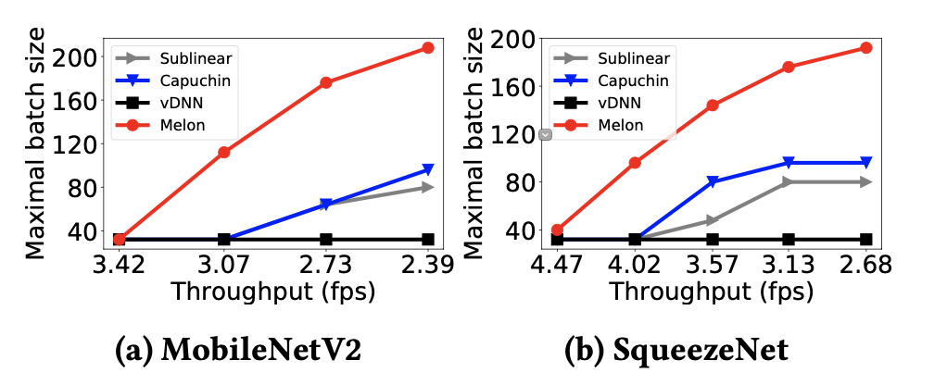
Evaluation: end2end
Achieve larger batch size compared with baselines with same throughput
Notes:
For end2end performance, we evaluate maximal batch size supported.
(click)
Experiment result shows melon can Achieve larger batch size compared with baselines with same throughput

Slide 24
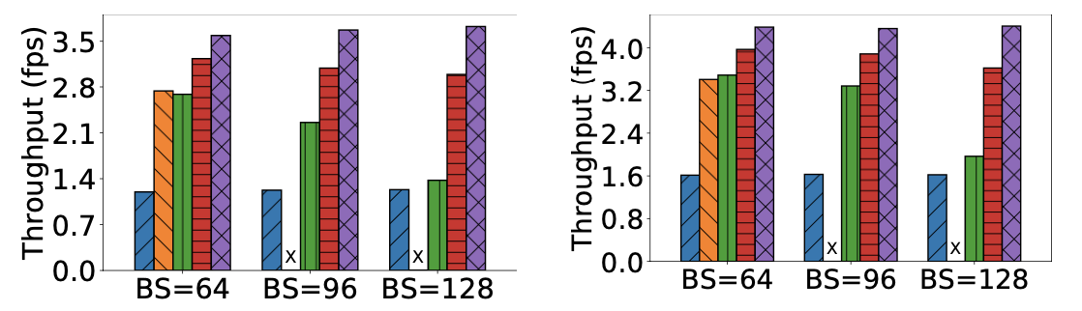
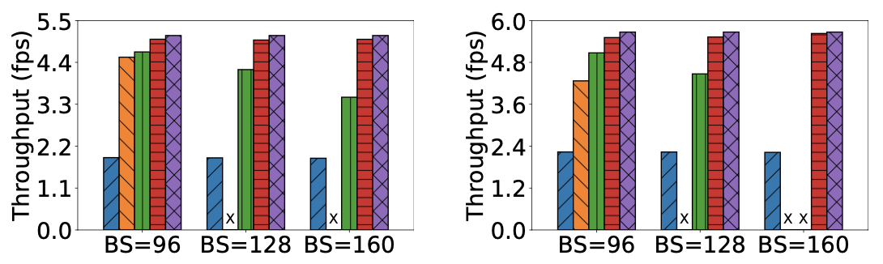
Evaluation: end2end
Achieve much larger batch size with same throughput
Achieve much higher throughput with same batch size
MobileNetV2
With BN
SqueezeNet
With BN
MobileNetV2
Without BN
SqueezeNet
Without BN
Notes:
When training with same batch size,
(click)
melon can also achieve much higher throughput compared with other methods.

Slide 25

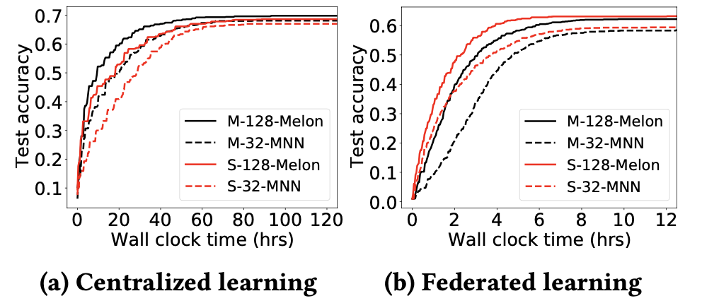
Evaluation: end2end
Achieve much larger batch size with same throughput
Achieve much higher throughput with same batch size
Achieve faster convergence rate and higher convergence accuracy
higher
convergence
accuracy
faster convergence rate
Notes:
We also conduct an end2end training experiment on cifar10 dataset, we can see that melon can achieve better training performance.
(click)
Especially in federated settings, Melon can achieve faster convergence rate and higher convergence accuracy.

Slide 26
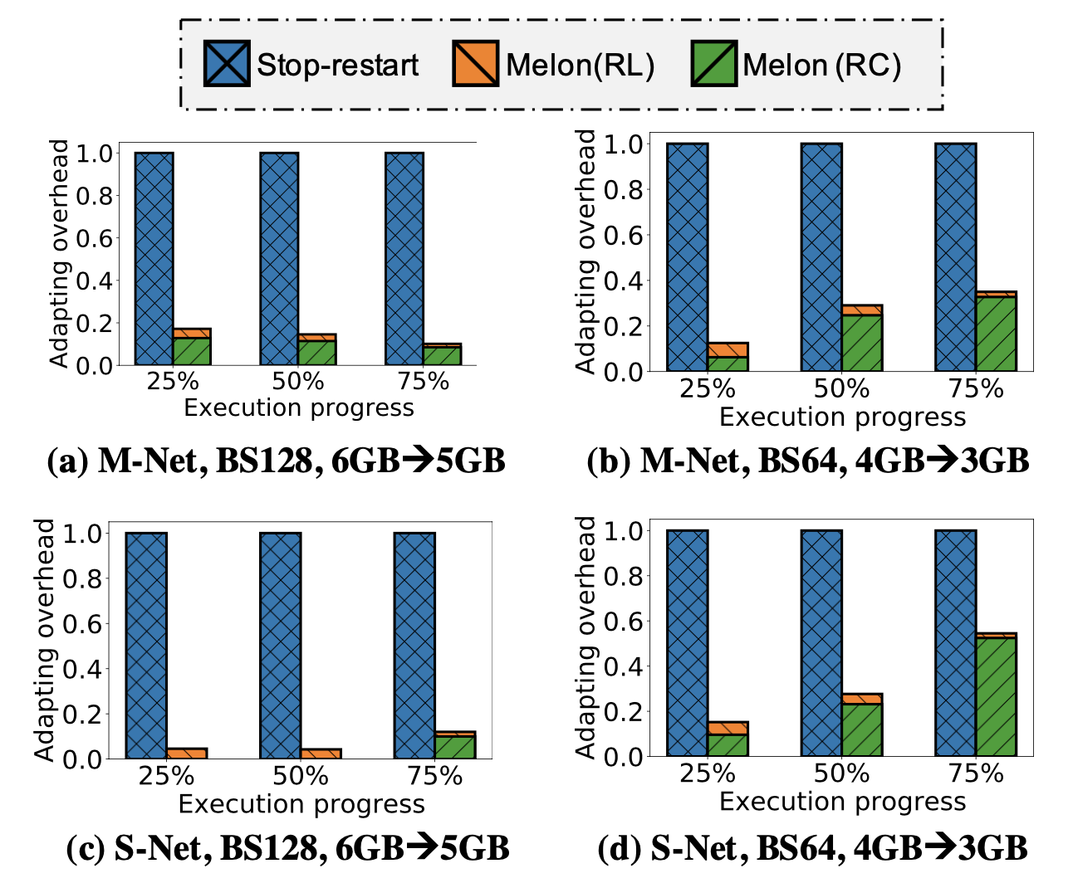
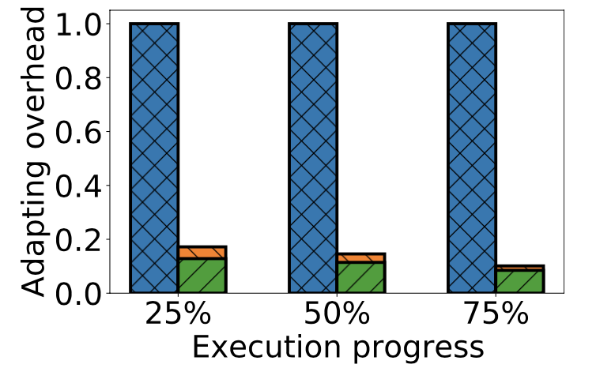
Evaluation: adaptation
Avoid less resource waste when memory budget changes
Efficient training context switch
Notes:
For adaptation, we evaluate the performance under difference training progress.
(click1)
For example, when training mobilenetv2 with batch size 128, memory budget changes from 6GB to 5GB.
(click2)
In such case, Melon can achieve more than 80% resource waste comparing with naive stop-restart baseline.

Slide 27
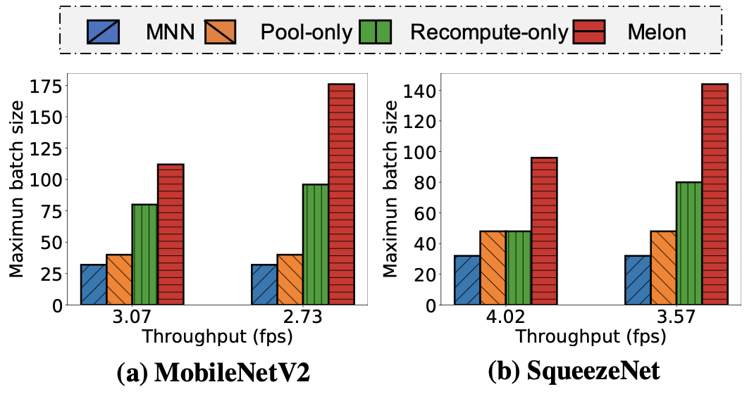
Evaluation: ablation
Each component contributes to the improvement
Total improvement
Recomputation
improvement
Memory pool
improvement
Notes:
We also evaluate contribution of each component. We evaluate the maximal batch size supported.
Take SqueezeNet as an example.
(click1)
We can see that both memory pool and recomputation can improve the performance.
(click2)
While applying both techniques, maximal batch size can boost to much higher one, because the memory access pattern keeps same for one model and one batch size.

Slide 28
Conclusion
Melon: an efficient on-device learning framework to break the memory wall
Tensor lifetime-aware memory pool
Memory-calibrated progressive recomputation
On-the-fly memory budget adapting
Implement a prototype and evaluate its efficiency
Open source: https://github.com/qipengwang/Melon
Notes:
In conclusion, we propose Melon, an efficient on-device learning framework to break the memory wall. Melon incorporates 3 novel techniques, that is
(click1)
Tensor lifetime-aware memory pool, Memory-calibrated progressive recomputation, and On-the-fly memory budget adapting.
(click2)
We implement a prototype of Melon and evaluate its efficiency.
(click3)
Melon has been open-sourced, all of the source code of Melon can be found here.

Slide 29


Thanks!
Memory Wall
Code:
https://github.com/qipengwang/Melon
wangqipeng@stu.pku.edu.cn
Notes:
Thanks for your listening.

